Slide 1
Lotterease Parent manual
PLEASE don’t use “Slide Show” for this PowerPoint, it cuts off the slides

Slide 2
Table Of Contents
How to view the applicant list
How to register a new account
How to log in to an existing account

Slide 3
How to view Applicant List

Slide 4
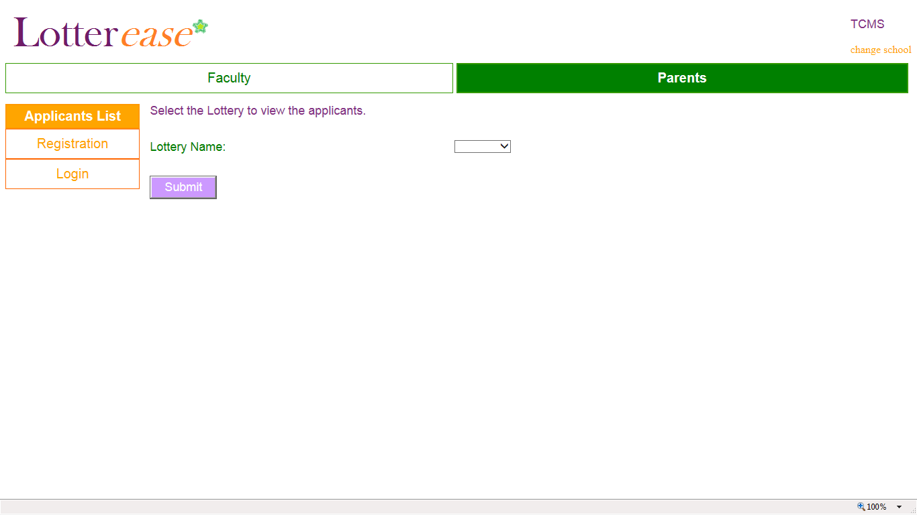
How to view the applicant list
(You are now in “Applicants List”)
Pick lottery name
You will arrive at this page when you click the link on your school website

Slide 5
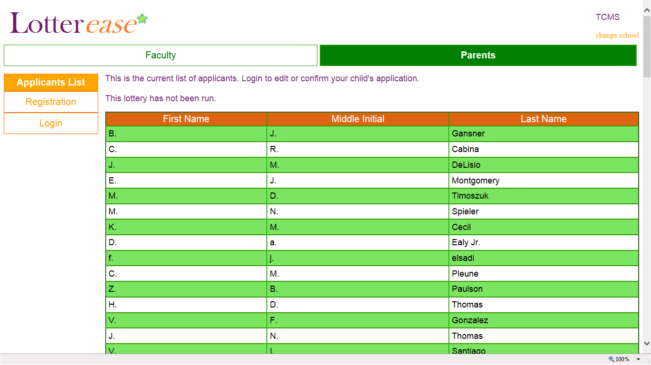
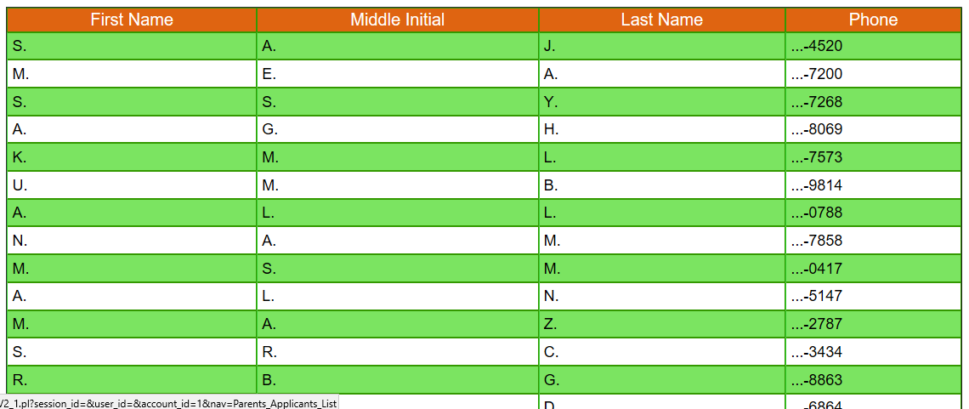
How to view the applicant list
Now you can view the applicant list.
*Hint*
You can press Ctrl-F to search for your child!
You can also log in to view your child's application.

Slide 6
How to register a new account

Slide 7
How to register a new account
Click on “Registration”

Slide 8
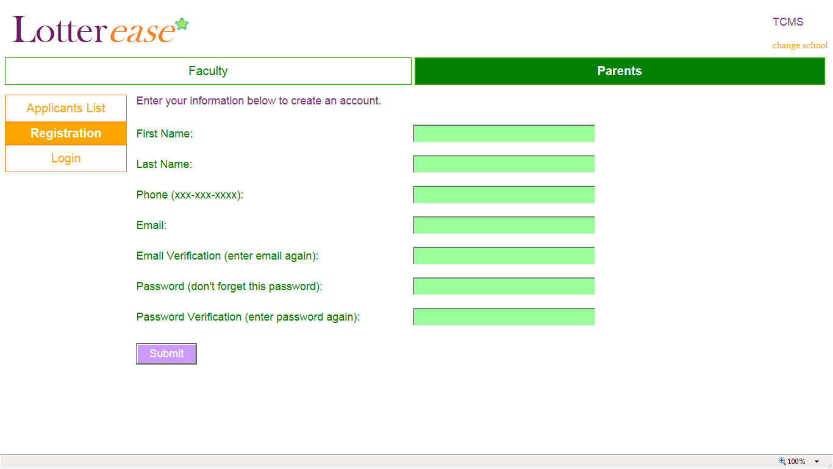
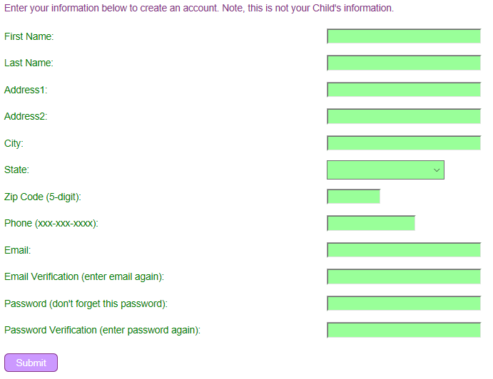
How to register a new account
(Fill it out) its YOUR information not your child's

Slide 9
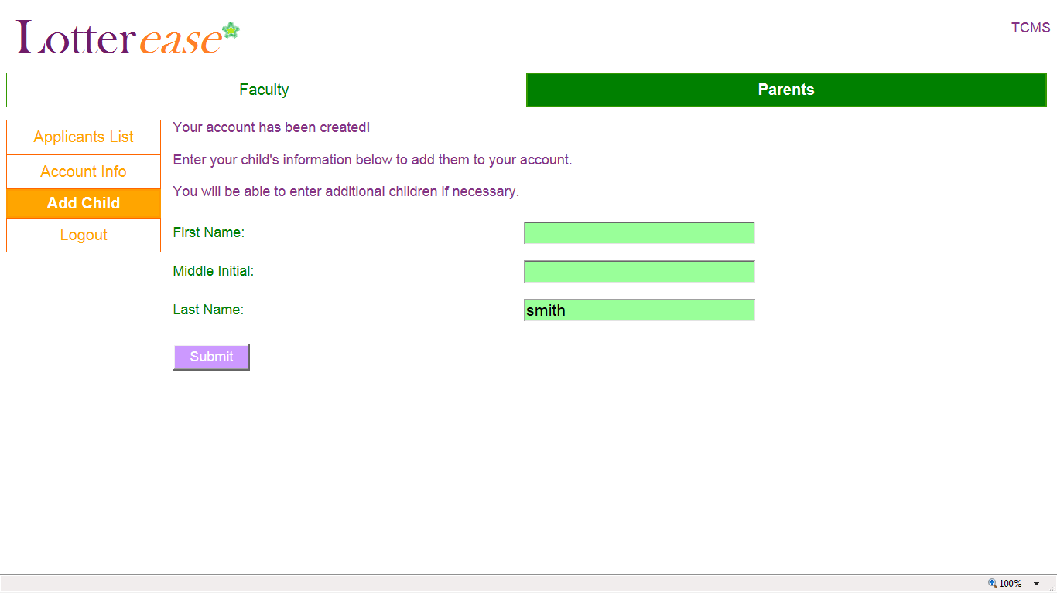
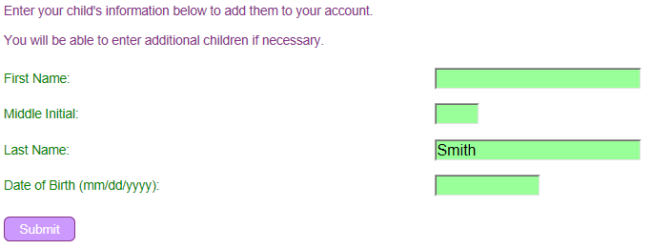
How to register a new account
(Your last name is already there)
Fill out CHILD’S info

Slide 10
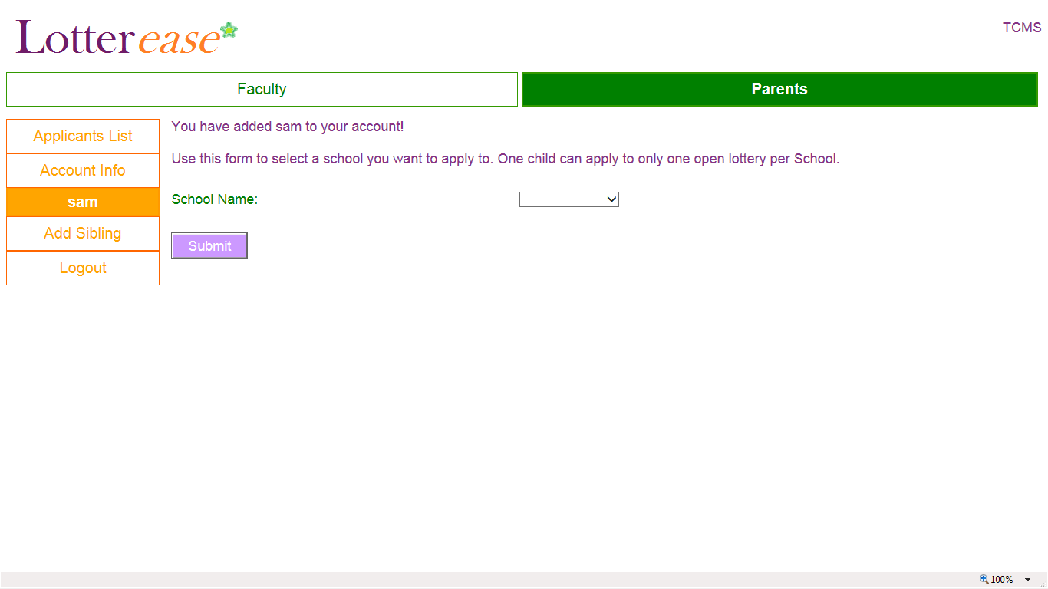
How to register a new account
Choose school

Slide 11
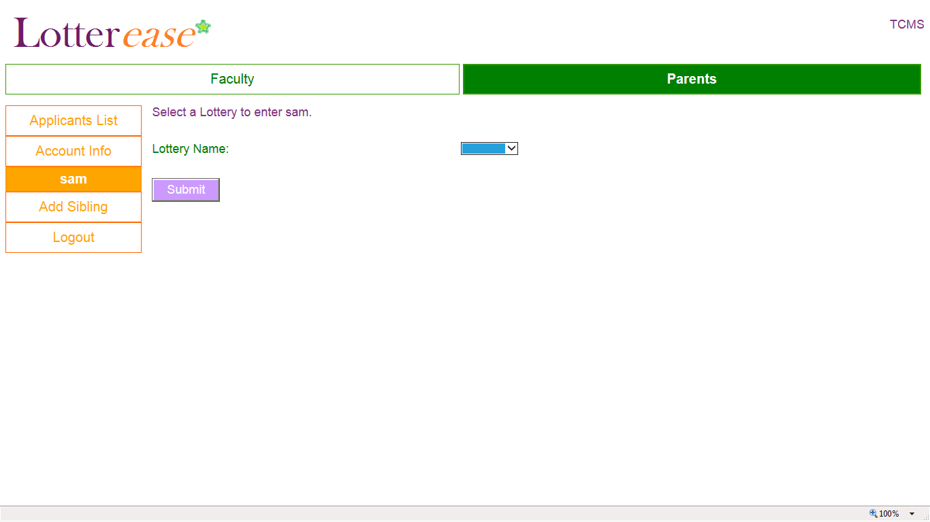
How to register a new account
Choose lottery

Slide 12
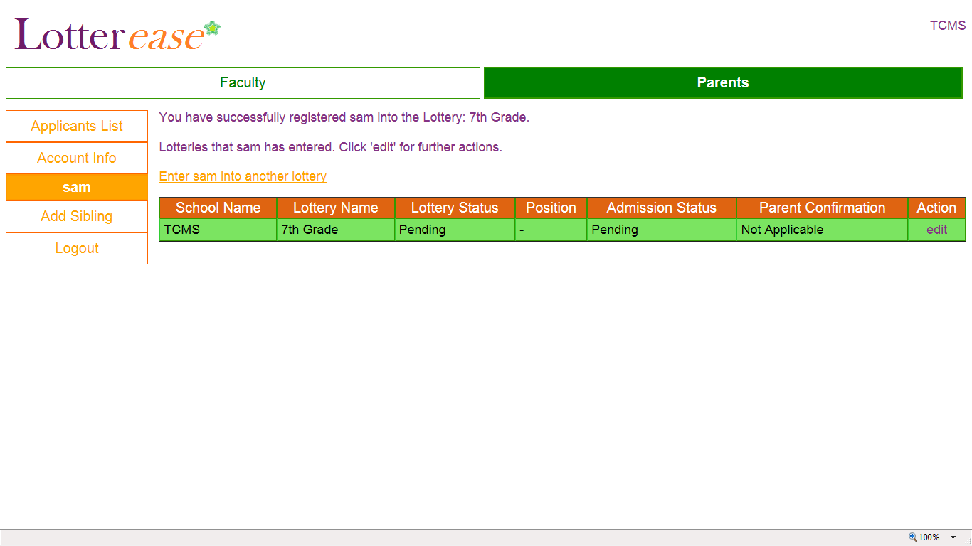
How to register a new account
Congrats! You have now entered your child in the lottery!
You can also enter your child in several lotteries at different schools by clicking this.
Click this to see options for your child’s account.
Do you have two children applying? Click this!

Slide 13
How to log in to an existing account

Slide 14
How to Log in to an existing account
Click here

Slide 15
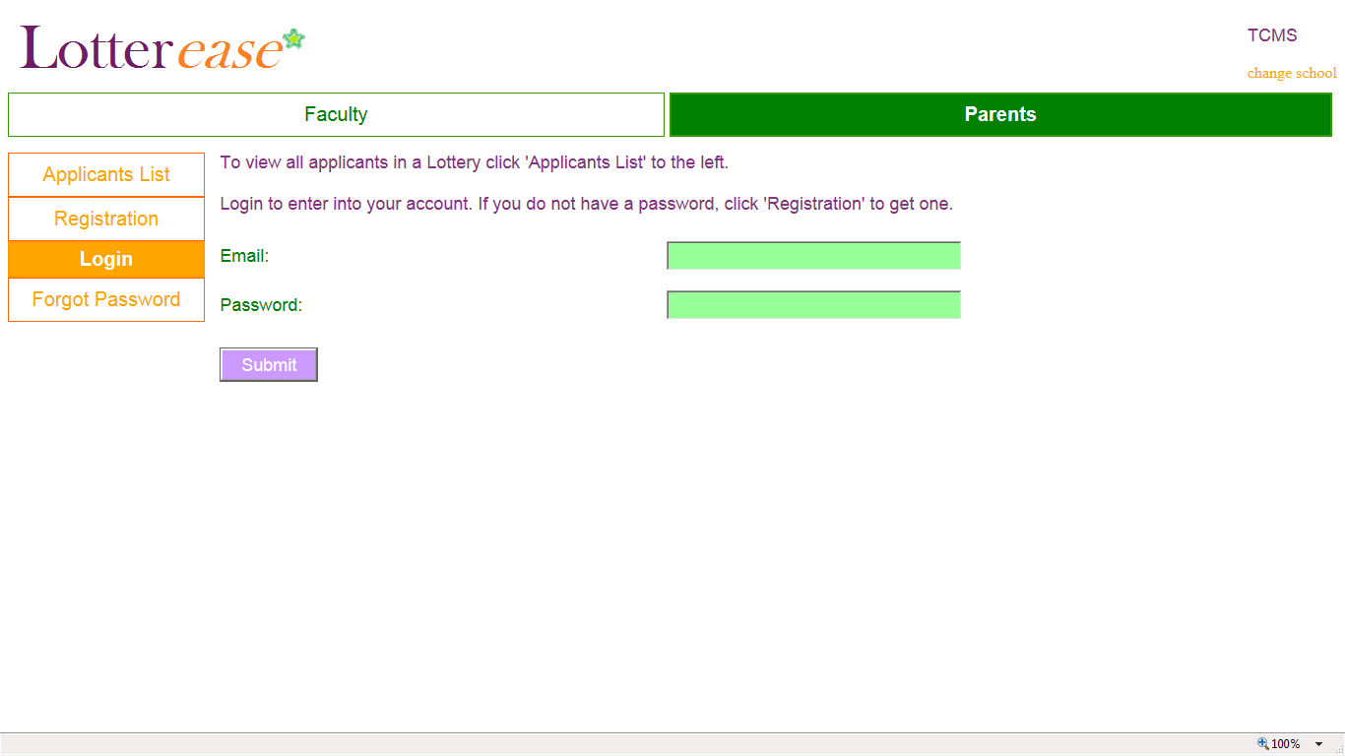
How to Log in to an existing account
LOG IN OF COURSE
Forgot password?

Slide 16
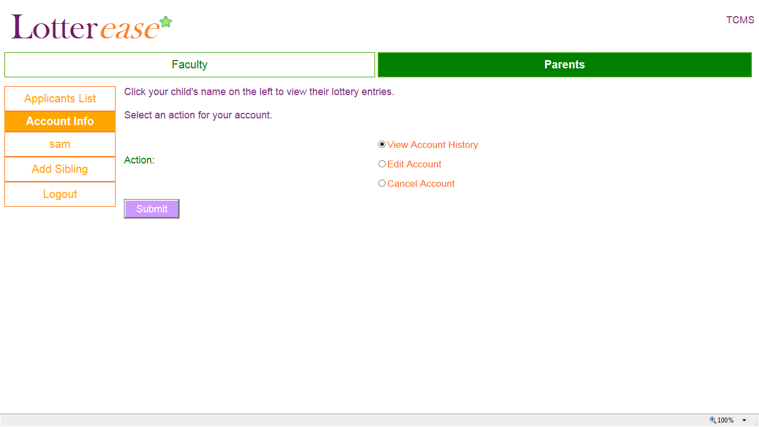
How to Log in to an existing account
You are now logged into your account!

